Slide 1
Temporal skewing huh??
Week 6a

Slide 2
I burned out an Arduino
Arduino Nano’s 5V power supply is a wimp!! Don’t take current from it!!
  Pulling ~50mA from the 5V pin burned out the Arduino’s voltage regulator leaving it partially shorted
  The Arduino worked for a while longer, although it was stressing the USB port and causing other USB devices to frequently shut down
  This was confirmed with a USB power monitor (e.g., <$4 https://www.ebay.com/itm/USB-Digital-Voltage-Charging-Tester-Power-Meter-Tester-Current-Charger-Monitor/174409336767 )
    Note: I bought a cheap one that was
    grossly inaccurate, my second one
    cost ~$25, has a gorgeous OLED
    display, and has been reliable

Slide 3
Bad connections …
Trust nothing, verify everything … (and don’t be paranoid …. Aaaaaaahhhhhhh!!!!!)
My black alligator clip wire had poor connections
  Identified the problem measuring a resistor’s resistance was unstable
  Isolated the problem by simplifying the loop
    Took out the resistor and 2nd clip lead
  Solved by soldering the wires to the alligator clips
  Validated solution by wiggling and seeing no more instability on ohmmeter
An earlier circuit revealed Vref was varying
  Turned out that was not “the problem”, but a consequence of drawing too much current from 5V pin, which eventually burned out the Arduino
  I suspected it was a proximal cause because of experience with instabilities in other Arduino circuits
    Thus I went down a wrong path …
    My prior experiences apparently weren’t as relevant as I thought

Slide 4
Good habits …
How do you verify everything?
  One at a time
  Develop good habits, e.g.,
    Every time your multimeter is set to ohms, 1st thing you do is measure the loop resistance of the leads and look for instability or offset
    Try to predict measurements, extraordinary results require additional validation
  Automate testing where possible

Slide 5
How fast can we vary the voltage pot?
Objective: Our Arduino program measures 3 voltages in rapid succession. If we adjust the power supply too quickly, then the first and last voltages will be different and our data will be skewed. Our goal now is to determine how fast is too fast to turn the knob.
Methods: [Think about it before advancing to the next slide]

Slide 6
How fast can we vary the voltage pot?
Objective: Our Arduino program measures 3 voltages in rapid succession. If we adjust the power supply too quickly, then the first and last voltages will be different and our data will be skewed. Our goal is to determine how fast is too fast to turn the knob.
Methods: Write an Arduino program that measures ~10 voltages as fast as it can, and prints them. We then turn the knob faster until we see voltage skew between the readings. The code is:
[try to write it yourself before advancing to the next slide]

Slide 7
Arduino Code
/*
how fast can we turn the voltage pot before we see voltage skew between the first and Nth measurement?
23sept20 BR
hardware: LM317 output -> voltage divider 10k/(10k+20k) -> A2
*/
#define VoutPin A2
#define VOLTS *(20+10)/10.0
#define NUMSAMPLES 10
volatile int Vout[NUMSAMPLES][3], i, j;
void setup()
{
Serial.begin(9600);
} // setup
void loop()
{
// get data fast
for (j = 0; j < 3; j++)
for (i = 0; i < NUMSAMPLES; i++)
Vout[i][j] = analogRead(VoutPin);
// print the results
for (j = 0; j < 3; j++)
{
Serial.print(j + 1);
Serial.print(": ");
for (i = 0; i < NUMSAMPLES; i++)
{
Serial.print(Vout[i][j]);
Serial.print("\t");
}
Serial.print("\n");
}
delay(200);
} // loop
Fun fact: This is the first time in many years that I’ve used 2-d arrays in C
File: howFastCanWeTurnThePot.ino

Slide 8
Results (turning the knob real fast)
1: 741 742 742 742 742 742 742 742 741 742
2: 742 741 742 741 742 742 741 742 742 742
3: 742 742 741 741 741 741 741 741 741 741
1: 421 421 420 420 419 418 417 417 416 416
2: 415 415 415 415 415 416 415 415 415 415
3: 415 416 416 415 414 414 414 414 415 414
1: 126 127 127 127 127 127 127 127 126 126
2: 127 126 126 125 126 126 126 125 124 125
3: 125 125 125 126 125 124 124 124 124 124
1: 206 206 206 206 206 206 206 207 207 206
2: 206 208 208 210 211 211 211 212 211 210
3: 210 210 209 208 208 209 208 208 209 209
1: 566 566 566 566 567 567 567 568 567 567
2: 567 567 567 567 567 567 566 566 567 567
3: 566 566 566 566 567 567 567 567 567 567
1: 741 741 741 743 742 743 742 741 742 741
2: 742 741 741 742 742 742 742 742 742 742
3: 741 741 741 741 742 742 743 742 742 742
1: 532 533 532 532 532 532 532 532 532 531
2: 531 530 531 530 530 530 530 529 529 529
3: 529 529 528 528 528 528 528 529 529 529
1: 168 168 168 169 169 170 170 169 169 169
2: 169 170 170 169 169 170 170 168 169 170
3: 168 169 168 168 168 169 168 168 168 169
1: 80 80 81 81 81 81 80 80 81 81
2: 82 80 80 80 80 80 80 80 80 80
3: 80 80 80 80 80 80 80 80 80 80
1: 264 266 266 266 266 266 266 267 267 268
2: 267 267 268 268 268 269 269 269 270 269
3: 270 270 269 270 269 269 268 268 267 268

Slide 9
Results (turning the knob real fast)
1: 741 742 742 742 742 742 742 742 741 742
2: 742 741 742 741 742 742 741 742 742 742
3: 742 742 741 741 741 741 741 741 741 741
1: 421 421 420 420 419 418 417 417 416 416
2: 415 415 415 415 415 416 415 415 415 415
3: 415 416 416 415 414 414 414 414 415 414
1: 126 127 127 127 127 127 127 127 126 126
2: 127 126 126 125 126 126 126 125 124 125
3: 125 125 125 126 125 124 124 124 124 124
1: 206 206 206 206 206 206 206 207 207 206
2: 206 208 208 210 211 211 211 212 211 210
3: 210 210 209 208 208 209 208 208 209 209
1: 566 566 566 566 567 567 567 568 567 567
2: 567 567 567 567 567 567 566 566 567 567
3: 566 566 566 566 567 567 567 567 567 567
1: 741 741 741 743 742 743 742 741 742 741
2: 742 741 741 742 742 742 742 742 742 742
3: 741 741 741 741 742 742 743 742 742 742
1: 532 533 532 532 532 532 532 532 532 531
2: 531 530 531 530 530 530 530 529 529 529
3: 529 529 528 528 528 528 528 529 529 529
1: 168 168 168 169 169 170 170 169 169 169
2: 169 170 170 169 169 170 170 168 169 170
3: 168 169 168 168 168 169 168 168 168 169
1: 80 80 81 81 81 81 80 80 81 81
2: 82 80 80 80 80 80 80 80 80 80
3: 80 80 80 80 80 80 80 80 80 80
1: 264 266 266 266 266 266 266 267 267 268
2: 267 267 268 268 268 269 269 269 270 269
3: 270 270 269 270 269 269 268 268 267 268
Spinning the knob fast results in little change in 30 adjacent analogReads()
  The biggest change was 421->414 = -7
Serial.print() (at 9600 baud) and/or the delay(200) is slow, so the voltage changes a lot between each cycle through loop()
  Biggest change was 532->168 = 364ADU * (4.8V/1023ADU)*3.2=5.5V
Conclusion: Its reasonable to expect there won’t be voltage skew from the power supply when averaging 10 sequential reads on 3 channels.
Questions???

Slide 10
Don’t Assume …
Measure!

Slide 11
Reflect
I spent lots of walking, biking, shower time thinking of (easy) ways to test things like we just did
There are many paths to the right answers
Unfortunately, there are infinitely more wrong answers
The more tools in your toolkit, the more choices you have
  Here I implemented a rarely used tool, the 2-dimensional C array, to simplify indexing and keeping track of 30 data points
Keep it simple
  I stayed with ADU units
  I didn’t compute averages or statistics – why?
    Because many statistics assume Gaussian or uniform distributions and the whole point is to validate the distribution of data
    I can eyeball the stats
    I don’t want to hide outliers
    I’m not going to do this test again and again … now that I know the answer

Slide 12
Reflect
Activities like this pay additional dividends …
  Not only did we verify how fast we can safely turn the voltage pot without skewing the data but we also …
  Practiced programming
  Got more familiar and intuitive with our Arduino
  Added a tool to our toolkit …
Teachers hate the question, “will this be on the final exam?” because learning something with that sole purpose is a waste of time and talent …
  Take every opportunity to practice and learn new skills, add new tools to your intellectual toolkits, realize unconventional uses and applications of tools
  Learn to innovate (create new connections between disparate things)
  With the world changing so fast, we never know what tools might be useful for some novel task
If there’s an easy way to test your understanding or theory, then go for it!! If you’re wrong, finding out sooner is much better than later!

Slide 13
Reflect
Should we change delay(200); to another value??
Any benefit to make it slower?
Any benefit to make it faster?
This is an example of “refactoring” – rethinking old code in light of new data …

Slide 14
Automating labs II.
We didn’t discuss the human-robot component – that the LM317 pot has to be manually turned to vary the voltage while data is being collected
  Forgetting to include such key steps or processes are an Achilles heel of automation projects
  We will later build a circuit enabling Arduino to control the LM317 voltage
Having the Arduino both control the apparatus and record responses adds huge automation capabilities
But first, let’s partially automate report generation!!

Slide 15
Matlab’s Live Scripts
Live scripts let us mix text, graphics, data, executable code, and output, together in a single interactive environment called the Live Editor
Make one in the editor by Editor → New → Live Script
Toggle between Text and Code mode with option-return
Pictures can be pasted into Text blocks
Execute the code with cmd-return
Icons on the top right scroll bar enable displaying of results below text or on the side, and hiding the code
Save as → Export to (Word, HTML, PDF, Latex) generates corresponding files for sharing

Slide 16
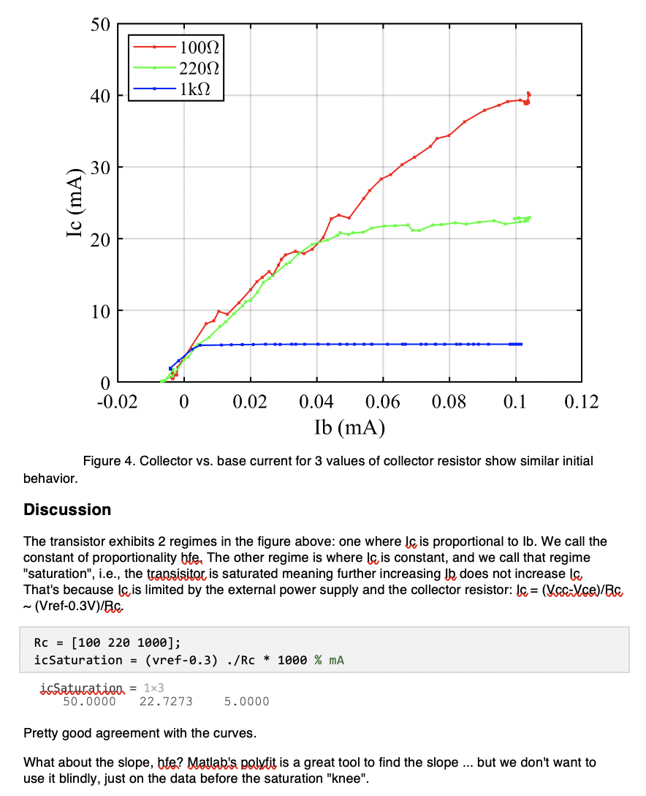
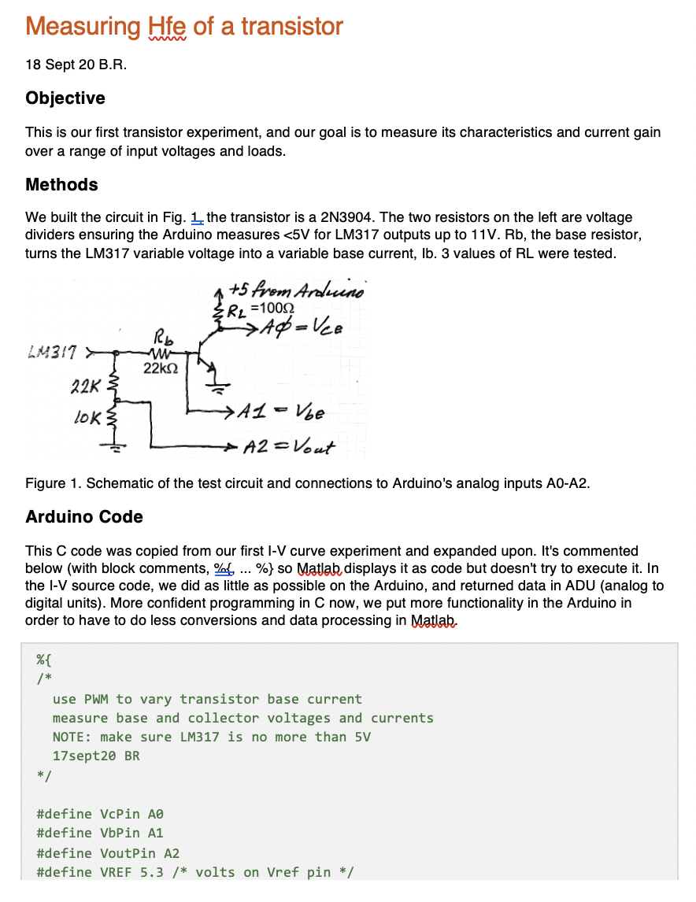
Example:
…
Update the data and the calculations and figures automagically change …
(BTW, noisy red & green curves from Vref instability, from too small R_{L})
…

Slide 17
Alternatives
Jupyter (www.jupyter.org) and Processing (www.processing.org) are two similar environments that merge programming with reporting … check them out!
The typewriter was replaced by the word processor (good luck finding one now)
Will these integrated environments replace the word processor for some scientific writing?
Consider that a word processor isn’t ideal for scientific publications

